Slide 1



Temperature Change Analysis Objectives
To uncover more information about Temperature change trends across the world.
To perform an initial data and exploratory analysis of the Temperature change data.
To formulate a hypothesis and to test it with regression analysis
Tools Used:
Source: Data are based on the publicly available GISTEMP data, the Global Surface Temperature Change data distributed by the National Aeronautics and Space Administration Goddard Institute for Space Studies(NASA-GISS)
http://www.fao.org/faostat/en/#data/ET/metadata

Slide 2
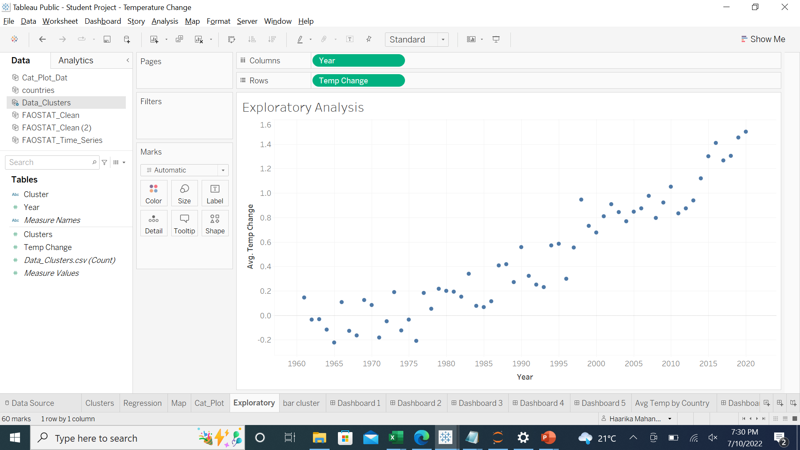
Exploratory Analysis
The exploratory analysis, shows that as the year advances, the average temperature of the earth is increasing. This upward trend will help us formulate the hypothesis:
As the Year progresses, the average temperature of the earth increases

Slide 3
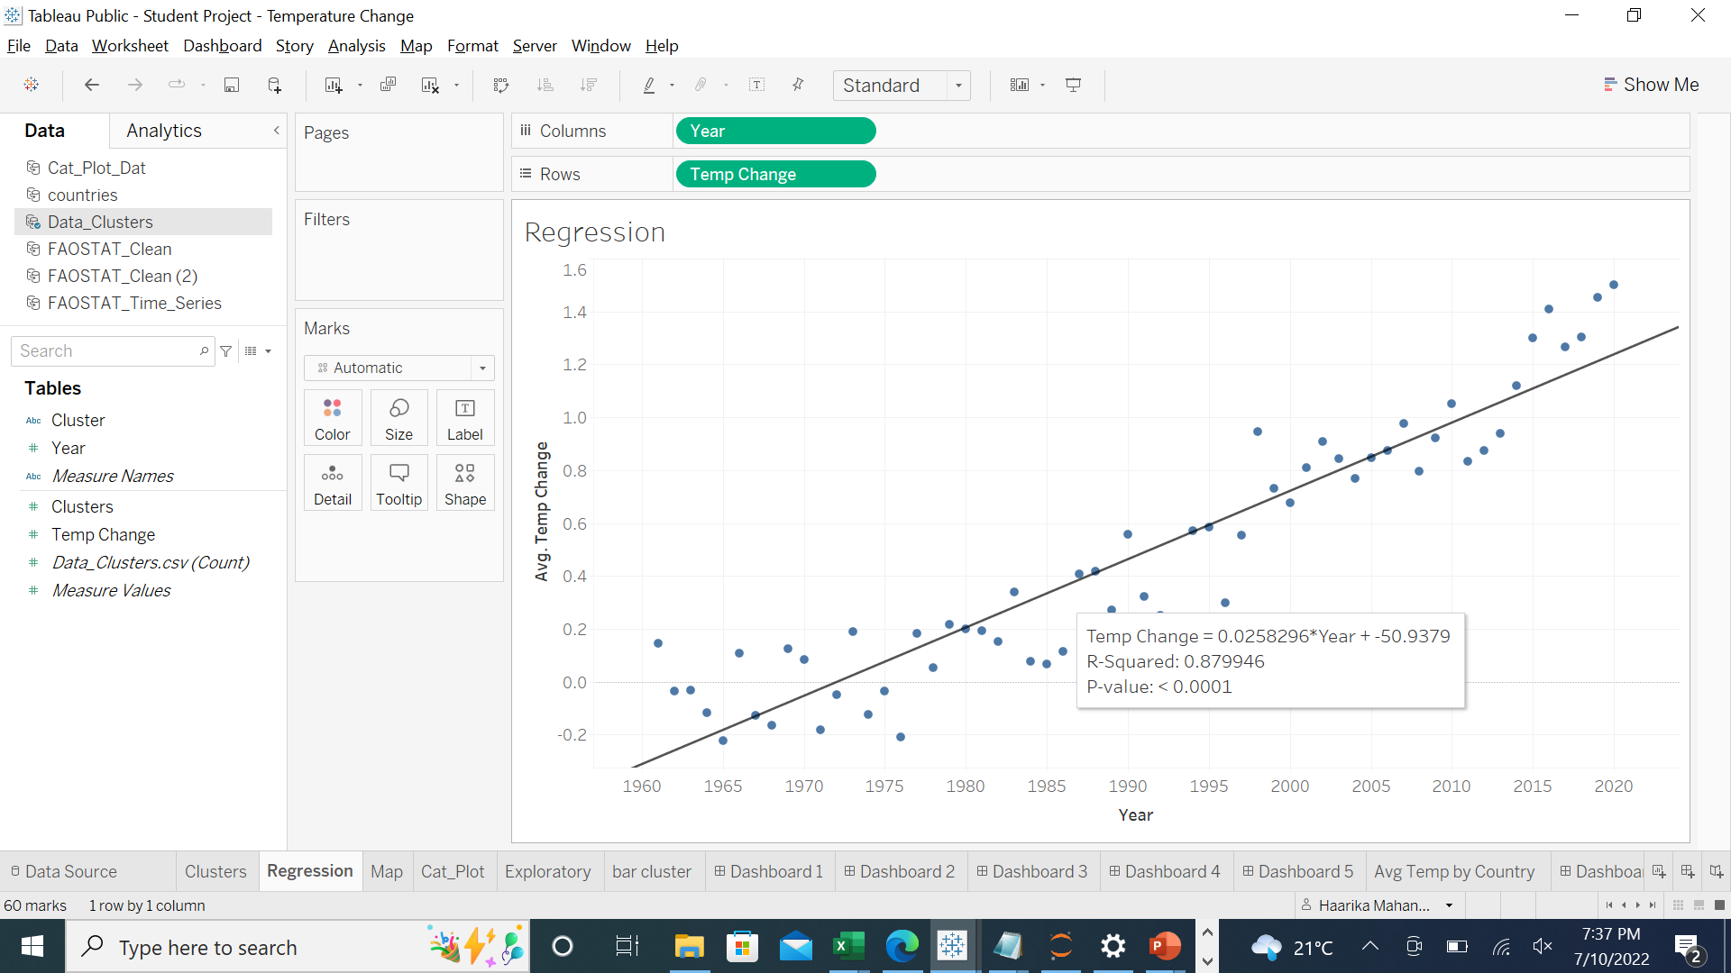
Linear Regression
To test the hypothesis that was formulated earlier with Regression analysis.
From the analysis, we can see that almost 88% of the average temperature data follow the trend. This shows that the hypothesis is proved.

Slide 4
Suggestions
From the analysis, it is evident that the temperature of the earth keeps rising as we progress in time.
The potential future effects of global climate change include more frequent wildfires, longer periods of drought in some regions and an increase in the number, duration and intensity of tropical storms.
Switching to renewable sources of energy where possible, driving electric vehicles where feasible, conserving energy by better insulating buildings/homes where affordable are some of the mitigation strategies we can use to slow the human caused global warming.
Data Presentation: Student Project - Temperature Change | Tableau Public

